Slide 1
The privacy-utility tradeoff

Slide 2
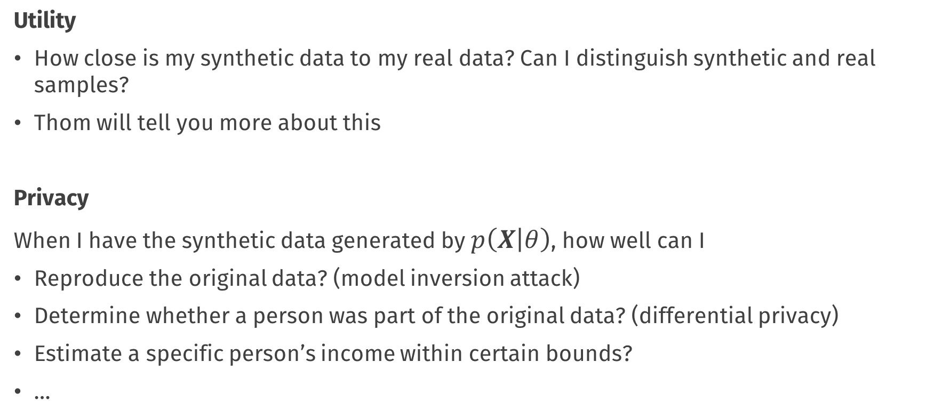
Utility vs. privacy
Utility
How close is my synthetic data to my real data? Can I distinguish synthetic and real samples?
Thom will tell you more about this
Privacy
When I have the synthetic data generated by $p\left(X | θ\right)$, how well can I
Reproduce the original data? (model inversion attack)
Determine whether a person was part of the original data? (differential privacy)
Estimate a specific person’s income within certain bounds?
…

Slide 3
Utility vs. privacy
Every parameter in the data-generating model contains information about the observations in the real data
The more parameters (information) you use to generate synthetic data, the more utility it will have
When the information in the parameters equals the information in the real data, we have just recreated the real data
At that point, there is no more privacy / disclosure control

Slide 4
Utility and privacy are opposites

Slide 5
How much does the synthetic data look like the real data?
I don’t know what I’m looking at
Perfect imitation
Utility
Privacy

Slide 6
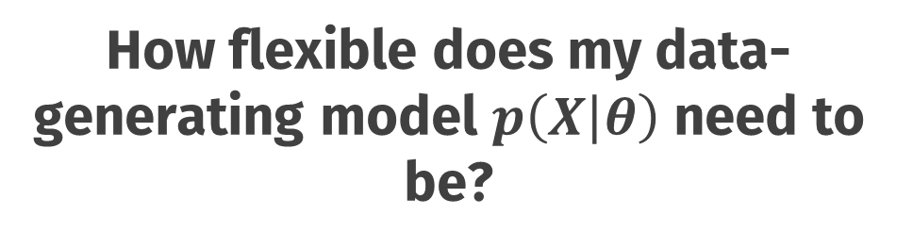
How flexible does my data-generating model $p\left(X | θ\right)$ need to be?
flexible
inflexible
Utility
Privacy

Slide 7
How flexible does my data-generating model $p\left(X | θ\right)$ need to be?
Huge classification and regression tree
Copula models
Just put 0 everywhere
Generative adversarial network with privacy penalties
Independent univariate
flexible
inflexible
Utility
Privacy
Fully conditional specification (mice, synthpop)

Slide 8
What can we do with the synthetic data?
Anything you can do with real data
Nothing
Utility
Privacy

Slide 9
What can we do with the synthetic data?
Investigate & answer all your research questions
Getting to know the data
Use the data as a toy example
Develop & validate data analysis scripts and pipelines
…
Find out how much your colleagues earn
Anything you can do with real data
Basic correlation analysis
Nothing
Utility
Visualisation of association
Privacy
Visualisation of variation
Estimate parameters with low simulation error

Slide 10
Different methods for different use-cases

Slide 11
Let’s get started!
synthpop
metasynth
Utility
Privacy

Slide 12
Icons from the noun project
Scientist by Justicon
Idea by Icon
house tree by LUTFI GANI AL ACHMAD
Euro by Larea
people by Alice Design
Table by Alex Burte
Hacking by Alfredo
Paper by Egi Maulana
Scientist 2 by Justicon
Question by Anggara Putra
https://thenounproject.com/

Slide 13
Conclusions

Slide 14
Default light slide
Default subheading
This is the body of the text
Default subheading
Note that the text is not black, but “black, text 1, lighter 25%”
Default subheading
This makes things easier on the eyes
Default subheading
This is the body of the text

Slide 15
Is this an impact slide?

Slide 16
Default light slide
This is the body of the text

Slide 17
Default dark slide
Default subheading
The dark slide brings some variation
Default subheading
It can highlight important aspects of the presentation.
Default subheading
This is the body of the text
Default subheading
This is the body of the text

Slide 18
Is this an impact slide?

Slide 19
Here is an impactful slide with a sentence on it.
Here is a topic related to the aforementioned question.

